Slide 1
Storage Devices Part 2
Instructor: Saba Iqbal

Slide 2
Magnetic Disk - Basics
Commonly used direct-access secondary storage device.
Physically, a magnetic disk is a thin, circular plate/platter made of metal or plastic that is usually coated on both sides with a magnetizable recording material such as iron-oxide
Data are recorded on the disk in the form of tiny invisible magnetized and non-magnetized spots (representing 1s and 0s) on the coated surfaces of the disk
The disk is stored in a specially designed protective envelope or cartridge, or several of them are stacked together in a sealed, contamination-free container

Slide 3
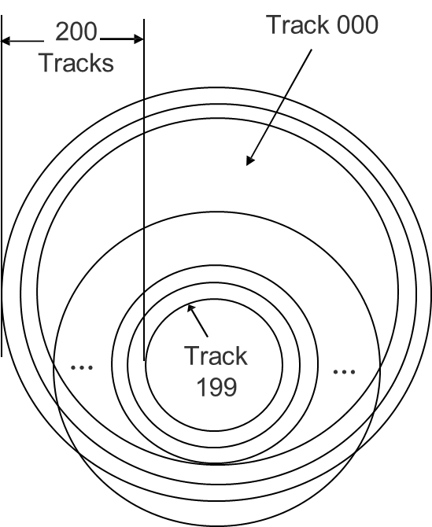
Magnetic Disk – Storage Organization Illustrates the Concept of Tracks
Tracks
A disk’s surface is divided into a number of invisible concentric circles called tracks.
The tracks are numbered consecutively from outermost to innermost starting from zero
The number of tracks on a disk may be as few as 40 on small, low-capacity disks, to several thousand on large, high-capacity disks

Slide 4
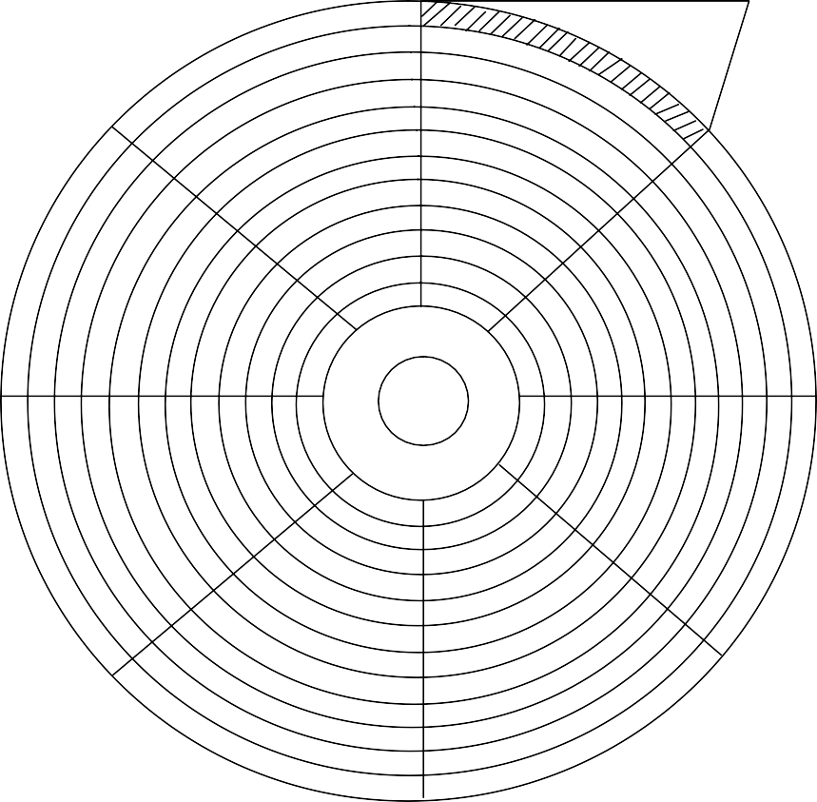
Magnetic Disk – Storage Organization Illustrates the Concept of Sectors
A sector
Sectors
Each track of a disk is subdivided into sectors
There are 8 or more sectors per track
A sector typically contains 512 bytes
Disk drives are designed to read/write only whole sectors at a time

Slide 5
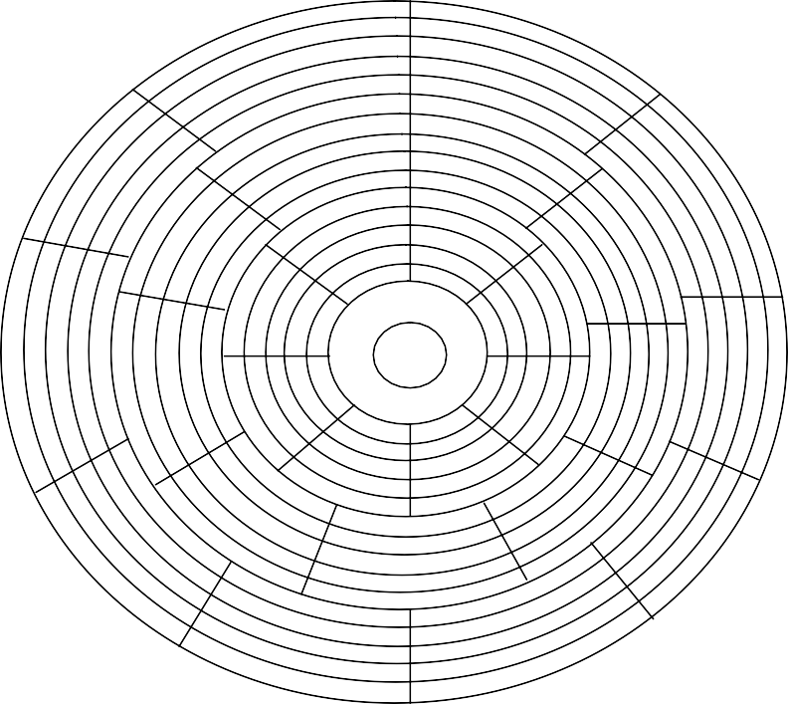
Magnetic Disk – Storage Organization
Illustrates Grouping of Tracks and Use of Different Number of Sectors in Tracks of Different Groups for Increased Storage Capacity
Innermost group of tracks has 8 sectors/track
Next groups of tracks has 9 sectors/track
Outermost group of tracks has 10 sectors/track

Slide 6
Magnetic Disk – Storage Capacity
Storage capacity of a disk system = Number of recording surfaces
Number of tracks per surface
Number of sectors per track
Number of bytes per sector

Slide 7
Magnetic Disk Pack – Access Mechanism
One read/write head per surface
Central shaft
Direction of movement of access arms assembly
Access arms assembly
Vertical cross section of a disk system. There is one read/write head per recording surface

Slide 8
Magnetic Disk – Access Time
Disk access time is the interval between the instant a computer makes a request for transfer of data from a disk system to the primary storage and the instant this operation is completed
Disk access time depends on the following three parameters:
Seek Time: It is the time required to position the read/write head over the desired track, as soon as a read/write command is received by the disk unit
Latency: It is the time required to spin the desired sector under the read/write head, once the read/write head is positioned on the desired track

Slide 9
Magnetic Disk – Access Time
Transfer Rate: It is the rate at which data are read/written to the disk, once the read/write head is positioned over the desired sector
As the transfer rate is negligible as compared to seek time and latency,
Average access time
= Average seek time + Average latency

Slide 10
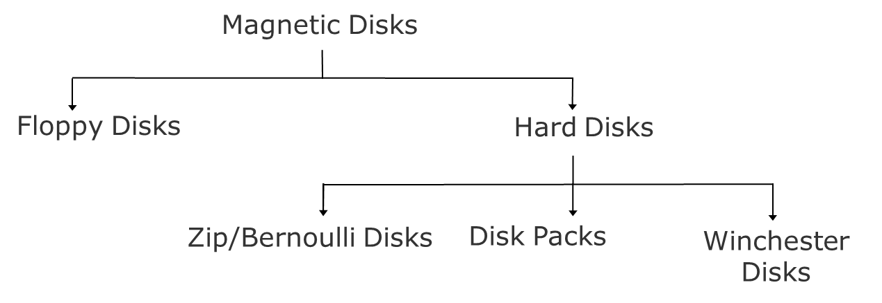
Types of Magnetic Disks

Slide 11
Hard Disks
Round, flat piece of rigid metal (frequently aluminium) disks coated with magnetic oxide
Come in many sizes, ranging from 1 to 14-inch diameter.
Depending on how they are packaged, hard disks are of three types:
Zip/Bernoulli disks
Disk packs
Winchester disks
Primary on-line secondary storage device for most computer systems today

Slide 12
Advantages of Magnetic Disks
More suitable than magnetic tapes for a wider range of applications because they support direct access of data
Random access property enables them to be used simultaneously by multiple users as a shared device. A tape is not suitable for such type of usage due to its sequential-access property
Suitable for both on-line and off-line storage of data

Slide 13
Advantages of Magnetic Disks
Except for the fixed type Winchester disks, the storage capacity of other magnetic disks is unlimited as many disks can be used for storing very large data sets
Due to their low cost and high data recording densities, the cost per bit of storage is low for magnetic disks.
An additional cost benefit is that magnetic disks can be erased and reused many times
Floppy disks and zip disks are compact and light in weight. Hence they are easy to handle and store.
Very large amount of data can be stored in a small storage space

Slide 14
Advantages of Magnetic Disks
Due to their compact size and light weight, floppy disks and zip disks are also easily portable from one place to another
They are often used for transferring data and programs from one computer to another, which are not linked together
Any information desired from a disk storage can be accessed in a few milliseconds because it is a direct access storage device

Slide 15
Advantages of Magnetic Disks
Data transfer rate for a magnetic disk system is normally higher than a tape system
Magnetic disks have less chances for data corruption due to careless handling or unfavorable temperature and humidity conditions than magnetic tapes

Slide 16
Limitations of Magnetic Disks
More difficult to maintain the security of information stored on shared, on-line secondary storage devices, as compared to magnetic tapes or other types of magnetic disks
For Winchester disks, a disk crash or drive failure often results in loss of entire stored data. It is not easy to recover the lost data. Suitable backup procedures are suggested for data stored on Winchester disks
Some types of magnetic disks, such as disk packs and Winchester disks, are not so easily portable like magnetic tapes
On a cost-per-bit basis, the cost of some magnetic disks is low, but the cost of magnetic tapes is even lower

Slide 17
Optical Disk – Basics
Consists of a circular disk, which is coated with a thin metal or some other material that is highly reflective
Laser beam technology is used for recording/reading of data on the disk
Also known as laser disk / optical laser disk, due to the use of laser beam technology
Proved to be a promising random-access medium for high-capacity secondary storage because it can store extremely large amounts of data in a limited space

Slide 18

Optical Disk – Storage Organization
Has one long spiral track, which starts at the outer edge and spirals inward to the center
Track is divided into equal size sectors
(a) Track pattern on an optical disk
(b) Track pattern on a magnetic disk
Difference in track patterns on optical and magnetic disks.

Slide 19
Optical Disk – Storage Capacity
Storage capacity of an optical disk
= Number of sectors
Number of bytes per sector
The most popular optical disk uses a disk of 5.25 inch diameter with storage capacity of around 650 Megabytes

Slide 20
Optical Disk – Access Mechanism
Laser beam source
Laser beam source
Prism
Prism
Sensor
Sensor
Laser beam gets reflect by a land (represents1)
Laser beam gets scattered by a pit (represents 0)
Land
Pit
Pit
Land
Pit
Land

Slide 21
Optical Disk Drive
Uses laser beam technology for reading/writing of data
Has no mechanical read/write access arm
Uses a constant linear velocity (CLV) encoding scheme, in which the rotational speed of the disk varies inversely with the radius

Slide 22
Types of Optical Disks
The types of optical disks in use today are:
CD-ROM
Stands for Compact Disk-Read Only Memory
Packaged as shiny, silver color metal disk of 5¼ inch (12cm) diameter, having a storage capacity of about 650 Megabytes
Disks come pre-recorded and the information stored on them cannot be altered
Provide an excellent medium to distribute large amounts of data in electronic form at low cost.

Slide 23
Types of Optical Disks
WORM Disk / CD-Recordable (CD-R)
Stands for Write Once Read Many. Data can be written only once on them, but can be read many times
Same as CD-ROM and has same storage capacity
Allow users to create their own CD-ROM disks by using a CD-recordable (CD-R) drive that can be attached to a computer as a regular peripheral device
Data to be recorded can be written on its surface in multiple recording sessions

Slide 24
Types of Optical Disks
Sessions after the first one are always additive and cannot alter the etched/burned information of earlier sessions
Information recorded on them can be read by any ordinary CD-ROM drive
They are used for data archiving and for making a permanent record of data. For example, many banks use them for storing their daily transactions

Slide 25
Types of Optical Disks
CD-Read/Write (CD-RW)
Same as CD-R and has same storage capacity
Allow users to create their own CD-ROM disks by using a CD-recordable (CD-R) drive that can be attached to a computer as a regular peripheral device
Data to be recorded can be written on its surface in multiple recording sessions
Made of metallic alloy layer whose chemical properties are changed during burn and erase
Can be erased and written a fresh

Slide 26
Types of Optical Disks
Digital Video / Versatile Disk (DVD)
Looks same as CD-ROM but has capacity of 4.7 GB or
8.5 GB
Designed primarily to store and distribute movies
Can be used for storage of large data

Slide 27
Advantages of Optical Disks
The cost-per-bit of storage for optical disks is very low because of their low cost and enormous storage density.
The use of a single spiral track makes optical disks an ideal storage medium for reading large blocks of sequential data, such as music.
Optical disk drives do not have any mechanical read/write heads to rub against or crash into the disk surface. This makes optical disks a more reliable storage medium than magnetic tapes or magnetic disks.

Slide 28
Advantages of Optical Disks
As data
once stored on an optical disk becomes
getting
permanent, danger of stored data inadvertently erased/overwritten is removed
Due to their compact size and light weight, optical disks are easy to handle, store, and port from one place to another

Slide 29
Limitations of Optical Disks
It is largely read-only (permanent) storage medium. Data once recorded, cannot be erased and hence the optical disks cannot be reused
The data access speed for optical disks is slower than magnetic disks
Optical disks require a complicated drive mechanism

Slide 30
Memory Storage Devices
Flash Drive (Pen Drive)
Relatively new secondary storage device based on flash memory, enabling easy transport of data from one computer to another
Compact device of the size of a pen, comes in various shapes and stylish designs and may have different added features
Plug-and-play device that simply plugs into a USB (Universal Serial Bus) port of a computer, treated as removable drive
Available storage capacities are 8MB, 16MB, 64MB, 128MB, 256MB, 512MB, 1GB, 2GB, 4GB, and 8GB

Slide 31
Memory Storage Devices
Memory Card (SD/MMC)
Similar to Flash Drive but in card shape
Plug-and-play device that simply plugs into a port of a computer, treated as removable drive
Useful in electronic devices like Camera, music player
Available storage capacities are 8MB, 16MB, 64MB, 128MB, 256MB, 512MB, 1GB, 2GB, 4GB, and 8GB

Slide 32
Lecture End

